Slide 1

The Deep Learning Revolution
IAT 806, Fall 2019
Prof. Philippe Pasquier
Pegah Kiaei
School of Interactive Arts and Technology,
Simon Fraser University

Slide 2
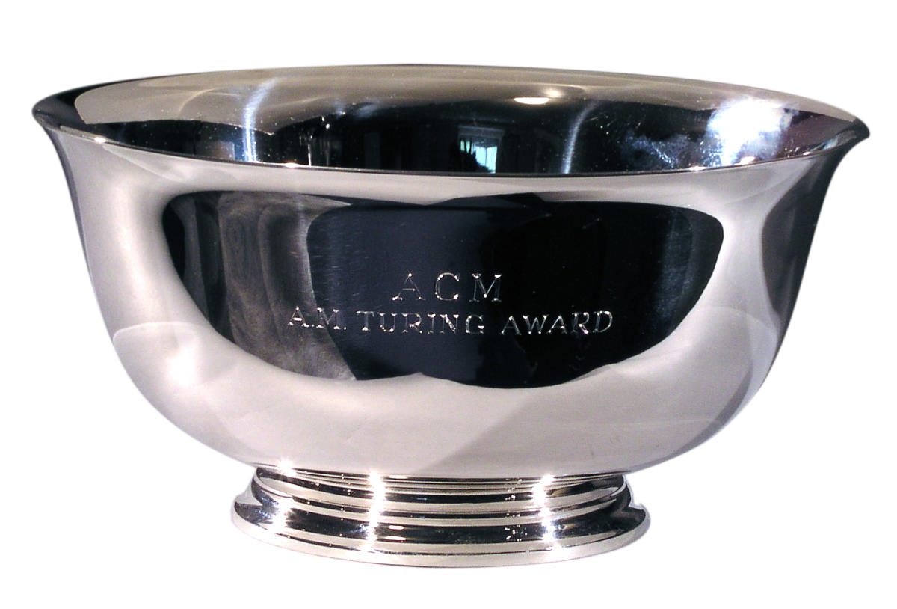
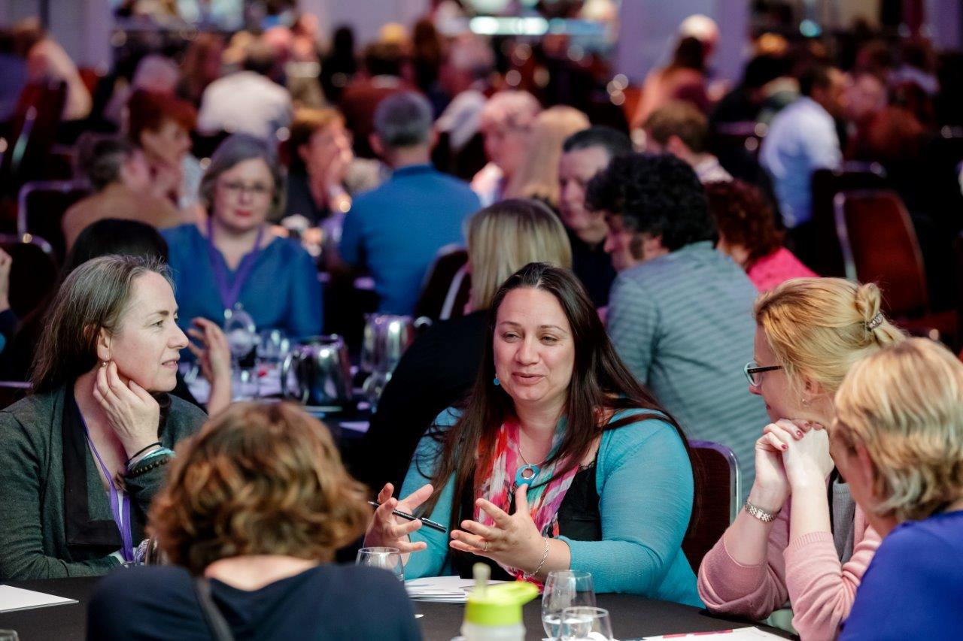
FCRC and Turing award
Notes:
Federated computing research conference is a one week conf happens every 4 years by ACM brings together
several academic conferences, workshops, and plenary talks in the field of computer science.
With acceptance rate of 27.7% sp, the touring award of this conf”is” sth special.
My presentation today is about the Turing talk presented by Turing award winners in this conf, in 2018.
This award annually goes to an individual selected for contribution “of lasting & major technical importance in computer filed”
The winners present a Turing lecture on their own choice.
https://www.google.com/url?sa=i&source=images&cd=&cad=rja&uact=8&ved=2ahUKEwi8pdLL6PblAhUNqp4KHUNNBp4Qjhx6BAgBEAI&url=http%3A%2F%2Fwww.fcrc.org.au%2Fconferences%2F2018-conference&psig=AOvVaw3D_YZPguXcJQ19kpagUOJs&ust=1574271489622641

Slide 3
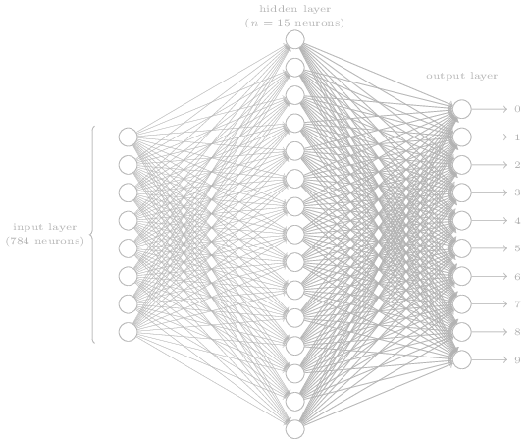
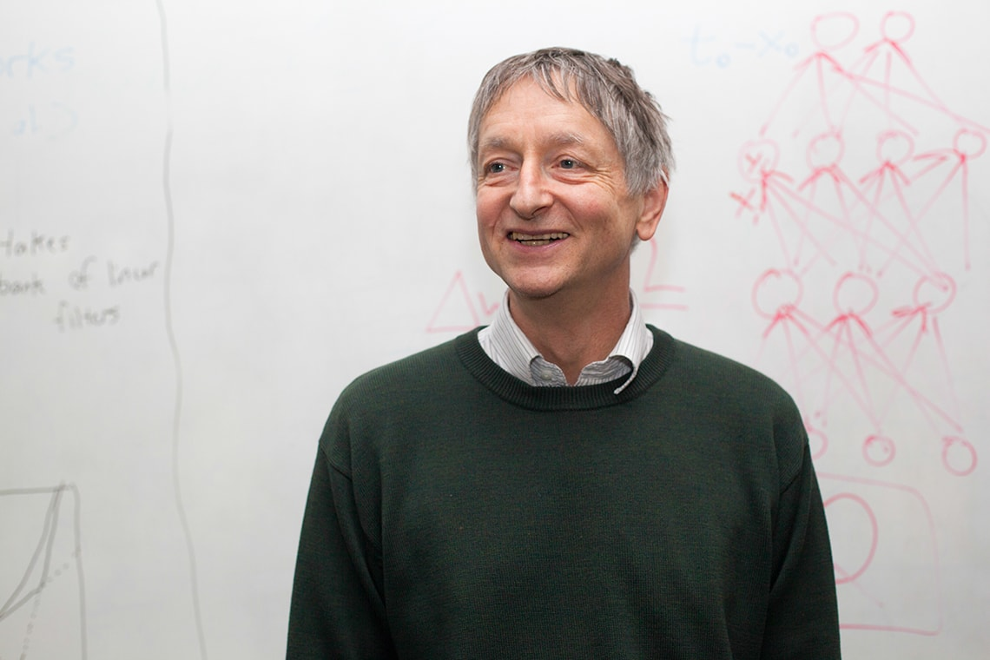
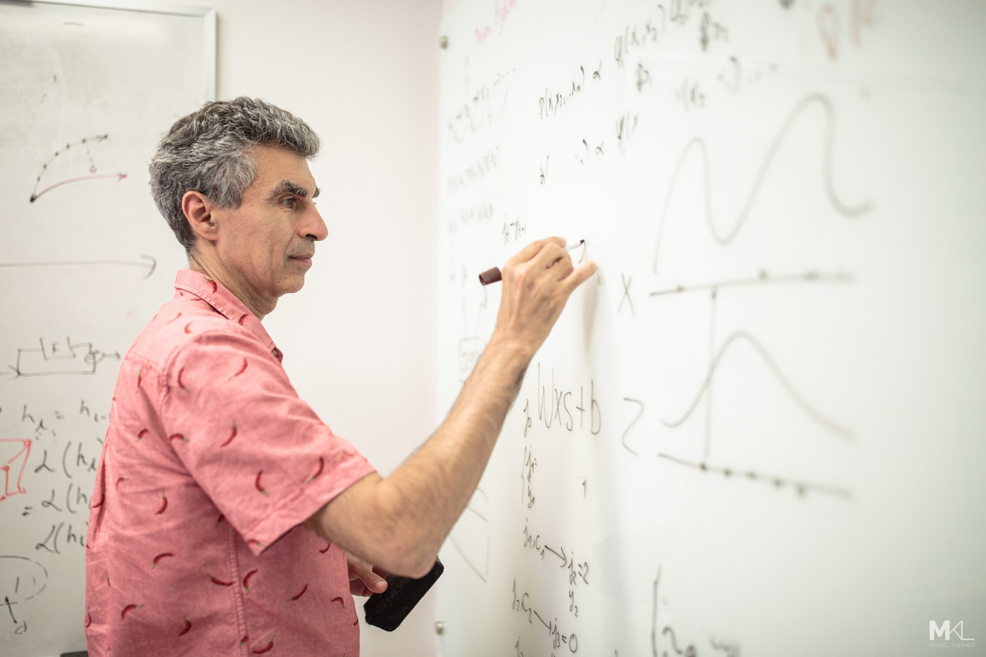
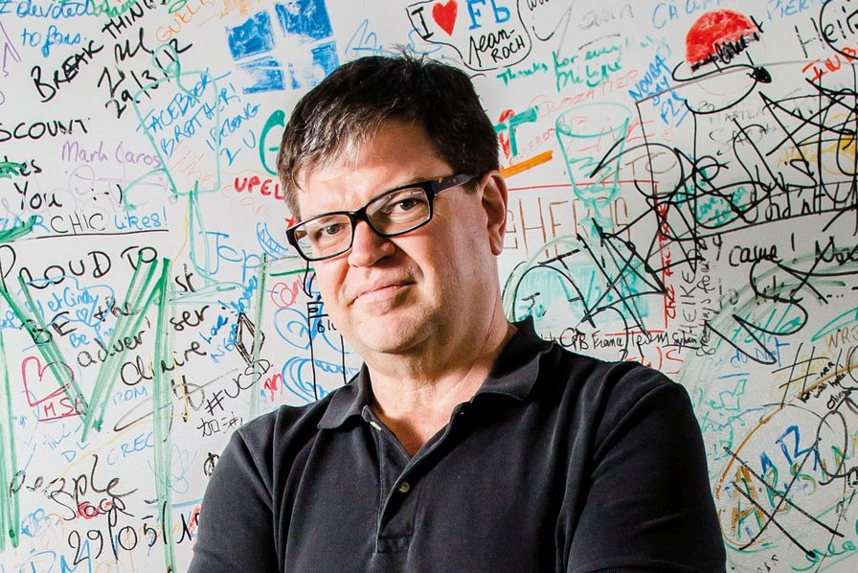
Geoffrey Hinton
University of Toronto. Carnegie Mellon University Kings College London, The University of Edinburgh
AAAI Fellow (1990)
Rumelhart Prize (2001)
IJCAI Award for Research Excellence (2005)
IEEE Frank Rosenblatt Award (2014)
Google(2013-),
BBVA Foundation Frontiers of Knowledge Award (2016)
James Clerk Maxwell Medal (2016)
Turing Award (2018)
Yoshua Bengio
Université de Montréal, MIT, McGill,
Co-founded Element AI(2016)
Marie-Victorin Prize (2017)
Turing Award (2018)
Yann LeCun
New York University ,Pierre and Marie Curie University ,ESIEE Paris
Bell Labs (1988-1996)
Founding director of the NYU Center for Data Science
VP and Chief AI Scientist at Facebook
Notes:
In 1969 the first paper on NN was published…defining a NN by electrical circuits.
And after that, for several decades research and interest in AI was almost non-existed
I say almost because some like Geoffrey Hinton Yoshua Bengio and Yann Lecun
Were convinced on the potential of nueral networks
They believed that a great big NN with many leyers and detectors features could actually learn anything
Geoffery Hinton, best known as the father of ML. as part of his professional history,
https://www.usinenouvelle.com/mediatheque/4/3/4/000625434_image_896x598/lecun.jpg
https://i0.wp.com/girlknowstech.com/wp-content/uploads/2017/10/yoshua-bengio-writing-board.jpg?ssl=1
https://www.utoronto.ca/sites/default/files/UofT3395_20130312_GeoffreyHinton%20%28web%20lead%29.jpg

Slide 4







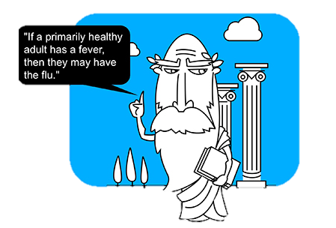


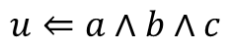
2 Paradigms for AI:
Symbolic Rules:
HOW DO WE GET COMPUTER TO DO REASONING AS PEOPLE DO?
Biological Inspired:
HOW TO GET THE SAME RESULT(EVEN BETTER) BY PURE LEARNING?
$$u⇐a∧b∧c$$
Notes:
SO, you may have question on what is this neural network.
Pulling the camera off a little bit…
So there are 2 paradigm for AI
One of them is through the symbolic rules or logic inspired approach-
-focus on reasoning and symbolic expressions
-and the main question of it is
We have a problem, we think about the problem, we find the solution and then by symbolic logic rules we tell the computer what to do.
These guys want to do AI by programming. And obviously we don’t know all the answers we cannot program in a way that computer find a meaning for this picture
However,
We can do so
in
biological approach
in which it focuses on learning and perception…
https://mapr.com/blog/artificial-intelligence-and-machine-learning-what-are-they-and-why-are-they-important/assets/image5.jpg

Slide 5
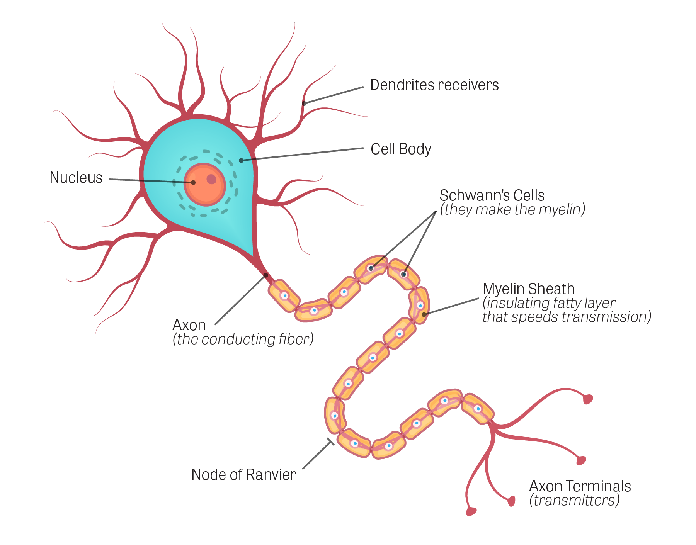
What is NN?
Receive
Process
Transmit
Notes:
So, what isNN?
Every thing begins with a neuron.
with its danderits, axons and synaptic terminals
Responsible for what happens in our brain, it receive, transmit and process incoming signals.
If we simplify this neuron to :

Slide 6

What is NN?(Cont.)
Notes:
Assuming this as an neuron with all parts,
and by hook these neurons up t a network, we get a NN!
And these neurons can connect to each other and form a NN

Slide 7
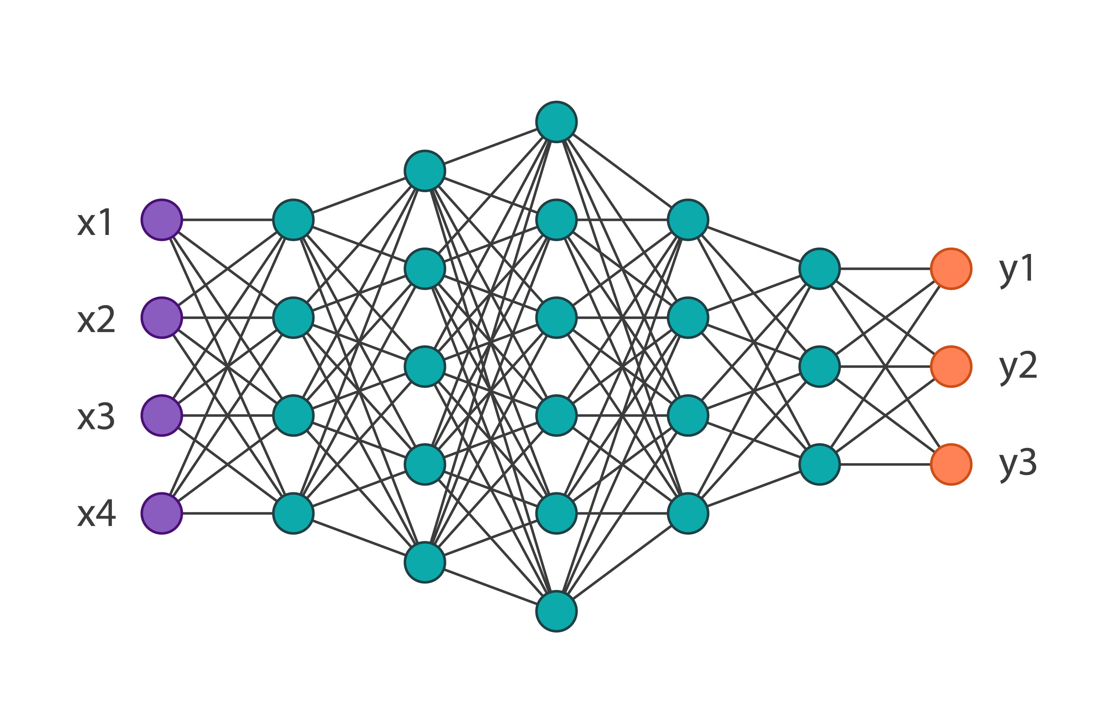




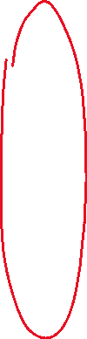



What is NN?(Cont.)
Notes:
Axons, cell body for the process and transmitting output to the next level
Those axons has weights associated with them and during the learning the NN learns by adjusting those weights.
Simply, if it does better, you keep the change if it does worse you throw it away
…mathematically, by an infinite amount of time and resource, they can predict any function!

Slide 8

Central Question
Can it does difficult tasks by starting from random data and acquiring all of its knowledge from training data?
Notes:
So we have this NN, many layers and wights…
But, can it do difficult tasks by starting from random data and acquiring all of its knowledge from training data?
Can they do object recognition by starting from random wights and training.?
Like recognising objects starting from random weights?

Slide 9
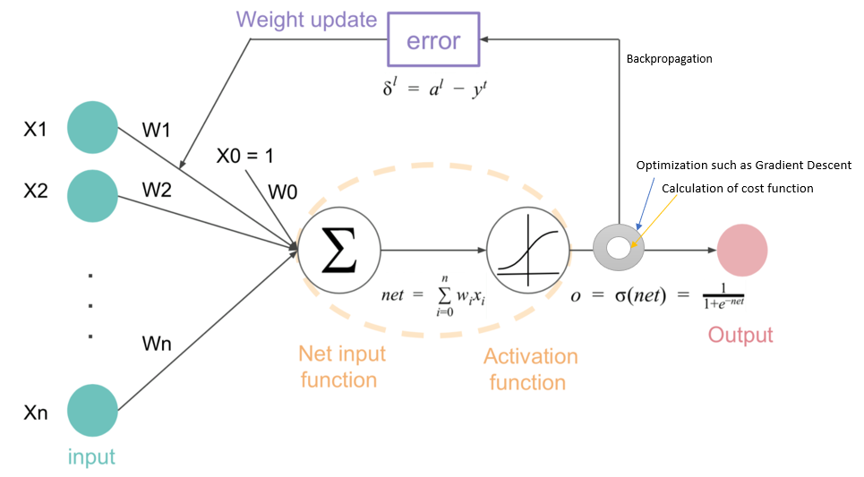
Back Propagation
Notes:
In 1980, Back propagation was introduced
Here, instead of tweaking and then waiting to see how it affects, changing and seeing the performance on “the network",
++ in each step the weight are modified to min the error between the network prediction and the actual target
Which means we can do all these things in parallel,
this, feature some how,
allowed NN to have multiple layers of features…then it looked as it would solve problems like speech recognition and shape reasoning

Slide 10
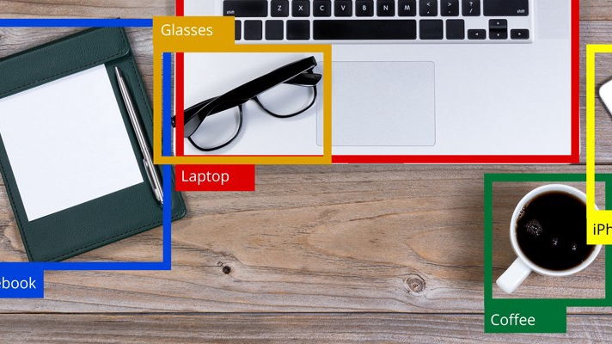
Back Propagation(Cont.)
After 30 years finally the Spring came.
A lot of labelled data
Convenient computer power for their processes(GPUs)
Deep NN beated other technologies in Google, IBM and MSR
Lead to Object Recognition(Computer Vision methods) and Machine Translation using NN
Notes:
And this was why after 10 years or so, With advances in technology, having
A lot of labelled data
Convenient computer power for their processes(GPUs) and later TPUs
they got that glimmer of hope they were looking for.
Deep NN beated other technologies in Google, IBM and MSR and now they aer using it everywhere.
https://miro.medium.com/max/900/1*EYtn2YE7b6MTzMQyD2R3nA.jpeg

Slide 11
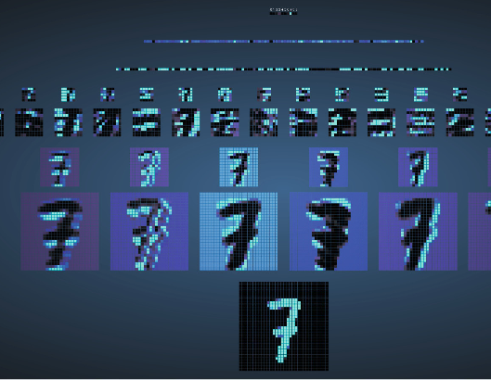
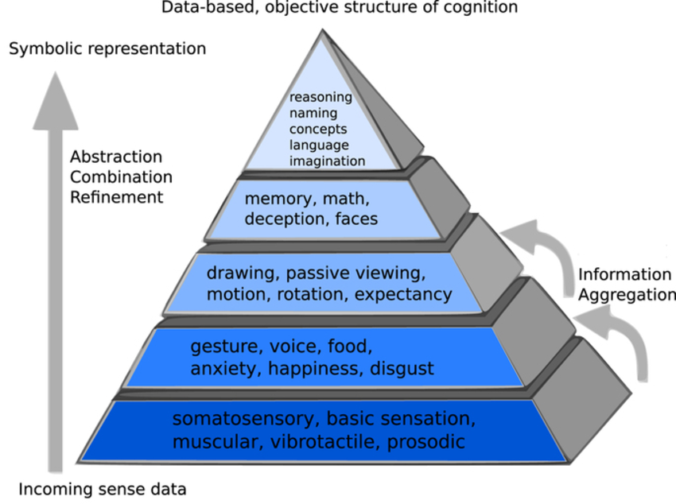
It is not over yet!
From CNN to Reasoning
Although computers do not recognize objects as we do
Notes:
So for the future of NN, Hinton thinks that although we now have cNN, as the last thing people do, the next level will be reasoning,
We cant do that yet, but…since this reasoning is on the top of pyramid, and we are almost familiar with down levels, we are more or less ready to start reasoning
Although computers do not recognize objects as we do, maybe with a big dd, reasoning works well but it doesn’t recognize thing as we do.some tweak may change their decision, while we do not understand it at all!
They use features like text, color and so on rather than geometry of objects and their “parts”

Slide 12

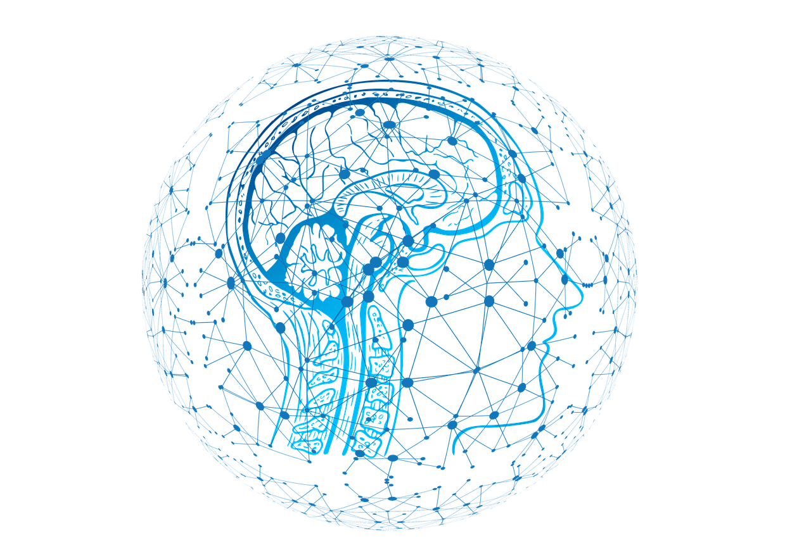
Finale
Notes:
We all know that AI is the most rapid field in society, and all these incredible advances wouldn’t have been possible without some of the foundation that these people established.
What they did for CV, Speech recognition and NLP is remarkable …
But it is worth to remind ourselves that These guys, won that award for30 years of work and enthusiasm in NN…
a field that was ridiculous for many for a long time.
from the winter of AI in1987 while no vision conf believed NN as a field, until 2012 till they got their first results,
and NN recognised objects faster in comparison with competitors,
Hintin, Benjio and LeCun didn’t disjoint…

Slide 13
https://www.google.com/url?sa=i&source=images&cd=&cad=rja&uact=8&ved=2ahUKEwi8pdLL6PblAhUNqp4KHUNNBp4Qjhx6BAgBEAI&url=http%3A%2F%2Fwww.fcrc.org.au%2Fconferences%2F2018-conference&psig=AOvVaw3D_YZPguXcJQ19kpagUOJs&ust=1574271489622641
https://mapr.com/blog/artificial-intelligence-and-machine-learning-what-are-they-and-why-are-they-important/assets/image5.jpg
https://www.usinenouvelle.com/mediatheque/4/3/4/000625434_image_896x598/lecun.jpg
https://i0.wp.com/girlknowstech.com/wp-content/uploads/2017/10/yoshua-bengio-writing-board.jpg?ssl=1
https://www.utoronto.ca/sites/default/files/UofT3395_20130312_GeoffreyHinton%20%28web%20lead%29.jpg
https://i.stack.imgur.com/7mTvt.jpg
https://www.google.com/url?sa=i&source=images&cd=&ved=2ahUKEwjQzcG8g_flAhVKrZ4KHbqYAHsQjRx6BAgBEAQ&url=https%3A%2F%2Fdsc-spidal.github.io%2Fharp%2Fdocs%2Fexamples%2Fnn%2F&psig=AOvVaw1wYsi0b9hKLgMRLTFANBuw&ust=1574278733467096
v https://www.securitymagazine.com/ext/resources/artificial-intelligence-3685928_1280.png?1559658311
https://i.stack.imgur.com/7mTvt.jpg
https://www.google.com/url?sa=i&source=images&cd=&ved=2ahUKEwjQzcG8g_flAhVKrZ4KHbqYAHsQjRx6BAgBEAQ&url=https%3A%2F%2Fdsc-spidal.github.io%2Fharp%2Fdocs%2Fexamples%2Fnn%2F&psig=AOvVaw1wYsi0b9hKLgMRLTFANBuw&ust=1574278733467096

Slide 14

Thank You

